Slide 1
Pest Risk Classification Using Random Forest with Cross-Validation
K. Aasritha Sai Lakshmi (2520090006)
TEAM 20
COURSE NAME: -MACHINE LEARNING
COURSE CODE: - 25SC2107E
Komali Varnika (2520090010)

Slide 2



CONTEXT & BACKGROUND
Introduction to Pest Risk Analytics
Agricultural Context
Machine Learning Role
Quantitative Value
Microclimate fluctuations accelerate destructive insect infestations.
Learns complex non-linear interactions across weather parameters.
Produces continuous numerical risk index for targeted protection.

Slide 3
CURRENT CHALLENGES
Problem Statement
Existing Limitations
Addressed Gap
• Reactive Scouting: Infestation detected after crop damage occurs.
• Proactive Forecasts: Pre-emptive pest alerts driven by weather trends.
• Qualitative Guesses: Lacks precise numerical risk quantification.
• Continuous Scoring: Regression values for granular risk tiers.
• Overuse of Chemicals: Blind pesticide spraying increases costs.
• Targeted Defense: Data-backed precision pesticide schedules.
Consequence: Substantial crop loss & environmental toxicity.
Result: Cost-efficient, sustainable agricultural intervention.

Slide 4
Algorithmic Fit
Economic Impact
Model Comparison
Production Ready
Ensembles excel on tabular agro-climatic data.
Minimizes crop yield destruction for farmers.
Benchmarked against standard Linear Regression.
Deployable via lightweight REST prediction APIs.

Slide 5
GOALS & TARGETS
Key Project Objectives
1
Data Preprocessing & Feature Scaling
Clean agricultural attributes and standardize multi-source environmental variables.
2
Unsupervised Exploratory Structure Analysis
Apply K-Means clustering and PCA to discover latent environmental data clusters.
3
Ensemble Model Training & Benchmarking
Train Random Forest Regressor and benchmark against Linear Regression baseline.
4
K-Fold Cross-Validation & Tuning
Execute k-fold cross-validation and optimize hyperparameters via GridSearchCV.

Slide 6
COMPARATIVE EVALUATION
Existing vs. Proposed System
Existing System
Proposed ML System
Manual Inspections: Subjective and labor-intensive field checking.
Data-Driven Models: Random Forest captures complex non-linear patterns.
Delayed Response: Warnings generated after visible plant damage.
Early Warning: Forecasts continuous risk score from weather trends.
Static Thresholds: Inflexible rule formulas failing across seasons.
Validated Reliability: Cross-validation guarantees generalization.
Status: High overhead and slow mitigation
Outcome: Objective, automated and scalable

Slide 7
TECHNICAL BLUEPRINT
System Architecture & Data Pipeline
1. Input Data
2. Preprocessing
3. EDA (PCA/KM)
4. Random Forest
5. REST Output
Temp, Humidity, Rain, Crop Age, Soil Moisture
Imputation, Outlier Capping, MinMax Scaling
K-Means Clusters & PCA Variance Mapping
Ensemble Regressor with K-Fold Validation
Risk Score Output & Performance Monitor

Slide 8

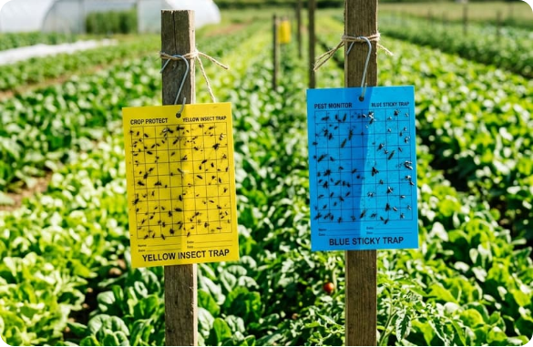
DOMAIN FOCUS
Precision Crop Monitoring & Scouting
Microclimate Correlation
High humidity and temperature spikes trigger severe pest proliferation.
Continuous Risk Scoring
Replaces arbitrary classifications with precise mathematical risk ratings.
Decision Support
Enables targeted pesticide allocation prior to visible canopy degradation.

Slide 9
Agricultural & Weather Features
• Temperature (°C): Daily thermal range influencing insect metabolism.
• Relative Humidity (%): Crucial catalyst for fungal-pest symbiosis.
• Rainfall (mm): Cumulative precipitation affecting canopy moisture.
• Crop Growth Stage: Vegetative, flowering, or maturity maturity index.
• Soil Moisture: Volumetric water content around root zone.

Slide 10
CORE ALGORITHM
Random Forest Regression Architecture
Why Random Forest?
• Ensemble Bagging: Combines de-correlated trees to minimize variance.
Hyperparameter Configuration
• Non-Linear Modeling: Naturally handles non-linear agronomic thresholds.
n_estimators
250 Trees
• Resistance to Overfitting: Bootstrap sampling stabilizes predictions.
max_depth
12 levels
min_samples_split
5 samples
• Feature Importances: Computes Gini-impurity and split gains.
Tuning Tool
GridSearchCV
Baseline Benchmark: Linear Regression used as comparative standard.

Slide 11
MODEL PERFORMANCE
Comparative Performance Evaluation
Evaluated Model | MAE (Error) | RMSE (Error) | R² Score | 5-Fold CV R²
Linear Regression (Baseline) | 4.82 | 6.14 | 0.684 | 0.679
Random Forest Regressor | 2.15 | 2.89 | 0.887 | 0.882
Error Reduction
Explained Variance
Cross-Validation Stability
-52.9% RMSE
88.7% R² Score
± 0.008 SD

Slide 12
MODEL EXPLAINABILITY
Pest Risk Factor Importance
Relative Humidity (%)
31.4%
Average Temperature (°C)
26.8%
Soil Moisture Index
18.5%
Crop Growth Stage
13.2%
Cumulative Rainfall (mm)
10.1%

Slide 13


IMPACT & ADOPTION
Applications & Project Advantages
Farmers & Growers
Agri-Extension Offices
Eco-Sustainability
Timely advisories reduce spray frequency and input costs.
Prioritizes regional surveillance and extension visits.
Minimizes chemical runoff into soil and local waterways.

Slide 14
Thank you!

